Slide 1
Embedded Systems Laboratory
Escape Room Puzzle #2 – Lights will guide you
By :
Shatakshi Sharma
Sougata Hanra
Santosh Kumar

Slide 2
Story Line!
SOLAR STORM has occurred!
Hard Shutdown
Emergency system turns on
Control Systems malfunctioning
Main goal
To get access to the MCB distribution
Upload the control software in the server

Slide 3
The Puzzle
Get access to the server room
Server room is password protected
The server room emergency power systems have limited resources and can power up only the system. One wrong switch will drain your power system
The power system switch boards are protected by a Tap-Tap pattern
Once you get access to the MCB distribution the “Lights will guide you”

Slide 4



Use case scenario
SERVER ROOM
ENTRY
Lights will guide you
Tap Pattern
Switch board to power on the server
Lights guiding the order of switches

Slide 5
How to solve the puzzle ??
Get access to the MCB distribution board
Solve a riddle to get the Tap-Tap pattern
Tap-Tap to get to the switch board
Turn on the switches in right sequence
Lights will guide you
Hint: The lights will give you the order of the switches that has to be turned on to power up the server

Slide 6


Tap Pattern
Pattern Matched ?
Piezo
Electric sensor
Servo Motor to open the switch board
Connected to other Modules Via MQTT

Slide 7


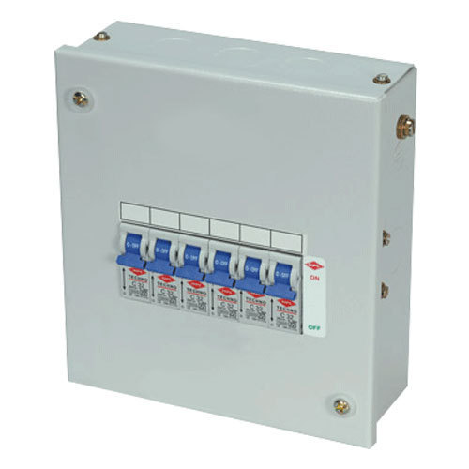
System Overview
MQTT
Tap-Tap
Open Switch Board
Lights will guide you
Tap-Tap pattern to access switch board
Order of switches to power on the server
Server switches on

Slide 8
Thank You !!

